Slide 1
Image Segmentation
Presentation by:-
Vishal Kumar Vishwakarma
Ravi Kumar

Slide 2
What is Image Processing?
Image processing is a method to perform some operations on an image, in order to get an enhanced image or to extract some useful information from it.
It aims at improving the quality of the image as far as visualization is concerned.
In this our input is original image and output is a processed image.

Slide 3
Image Analysis
Image Segmentation
Different Approches –
Discontinuity Based
Region Based
Different Edge Detection Operators
Linking of Edge Points

Slide 4
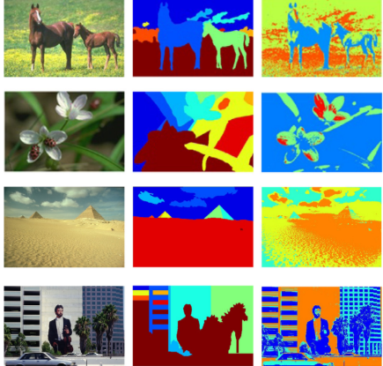
Image Segmentation
A process of subdividing an image into its constituent parts or objects in the image
Aim: Analysing substituent parts or objects once they are divided into objects to extract information.
Conclusion: Information extracted are useful for high level machine vision applications.

Slide 5
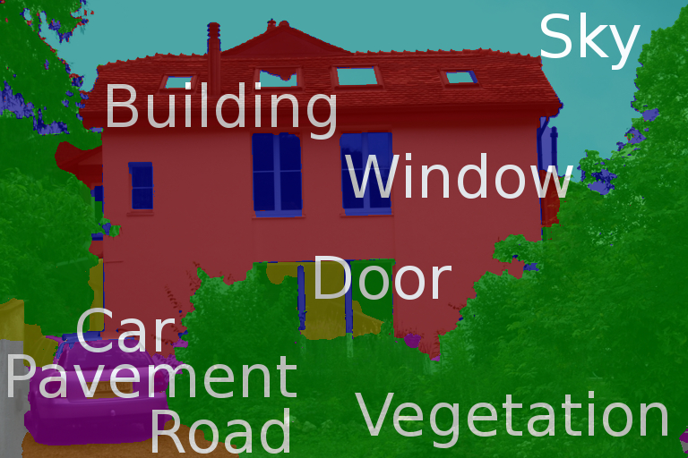
Level of Segmentation
Till what extent the image should be segmented?

Slide 6
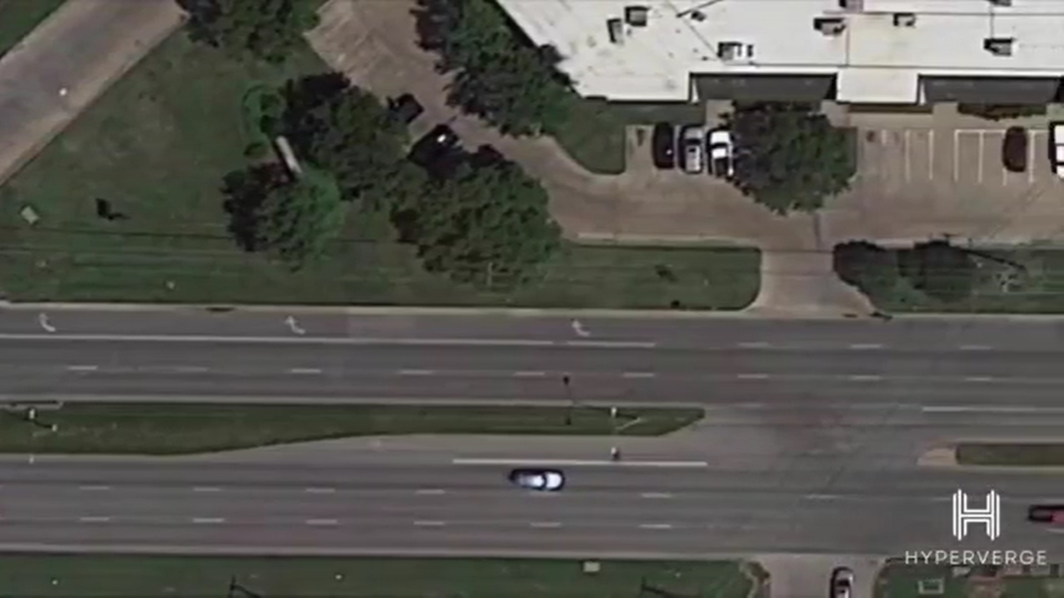
An Example
Detecting the Movement of a Vehicle
To detect movement pattern of different vehicles on Road :Aim
No need of Segmenting this part
(Area of No interest)
We segment this road
Then we segment vehicle

Slide 7
Different Approaches to Image Segmentation
Discontinuity based
Similarity based
Discontinuity Based
The partition or subdivision of an image is carried out on some abrupt changes in gray or intensity level. Here we are mainly interested in say isolated points or identification of lines and edges.
Similarity Based
Here we try to group those pixels in image which are similar in some sense. The simplest approach under this technique is Thresholding.

Slide 8
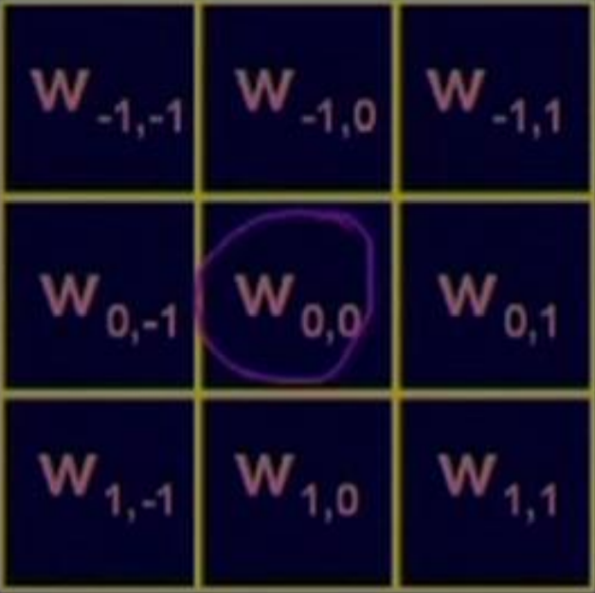
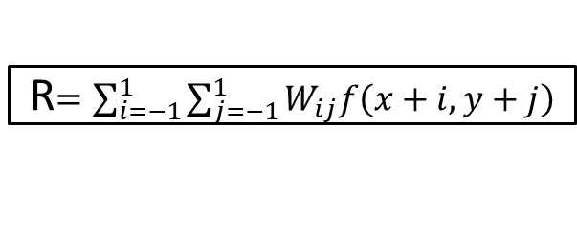
Discontinuity Based Techniques
It is done by using characteristics of variations of intensity values when there is variation of intensity while transition from brighter to darker region or vice versa.
Aim : To detect isolated Points, Lines or Edges using mask
R$=\sum_{i=−1}^{1}{\sum_{j=−1}^{1}{W_{ij}f\left(x+i,y+j\right)}}$
For eg- If all mask coefficient is equal to 1 then this technique will be used for image smoothening.
A point is detected at location (x,y) in an image where mask is centered if corresponding value
|R| > T (non-negative threshold value)

Slide 9
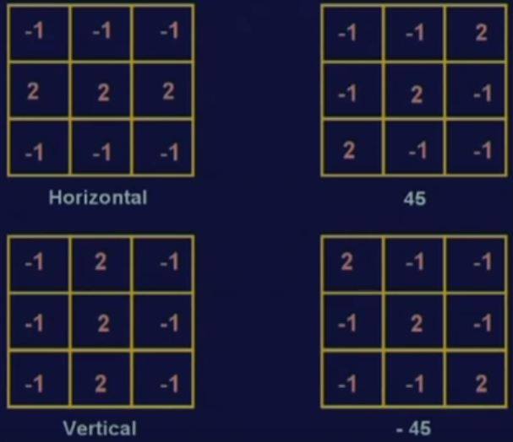
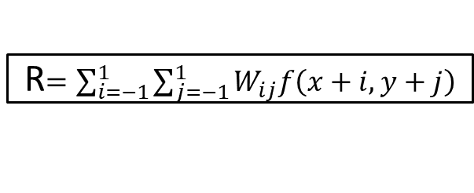
Discontinuity Based Techniques
Line Detection
For Line detection we apply all the four masks, namely Horizontal, Vertical, line inclined at 45 degrees and line inclined at -45 degrees .
The points which are detected using horizontal line detection by mask will contain all points in horizontal direction.
Similarly the same scenario applies for vertical, and other two detections respectively.
R$=\sum_{i=−1}^{1}{\sum_{j=−1}^{1}{W_{ij}f\left(x+i,y+j\right)}}$
Now there is condition which follows that while using masks over entire image, say i_{th} mask or j_{th} mask and if |R_{i}|>|R_{j}| for all i≠j
Then points detected is more likely to be contained on line in direction of mask i.

Slide 10
Discontinuity Based Techniques
Edge Detection
It is the most common approach for detection of discontinuity of image.
Edge: It is the boundary between two regions having distinct intensity levels
The points which are detected using horizontal line detection by mask will contain all points in horizontal direction.
Similarly the same scenario applies for vertical, and other two detections respectively.
R$=\sum_{i=−1}^{1}{\sum_{j=−1}^{1}{W_{ij}f\left(x+i,y+j\right)}}$
Now there is condition which follows that while using masks over entire image, say i_{th} mask or j_{th} mask and if |R_{i}|>|R_{j}| for all i≠j
Then points detected is more likely to be contained on line in direction of mask i.

Slide 11
Contact Information

